Slide 1
Apartment Sales in Poland
Szymon’s DYFS day - 2024

Slide 2
Scenario - Imagine that…
Sales Department from a company called “(Not So) Real Estate Poland” gathers info about the apartments for sales in Poland.

Slide 3
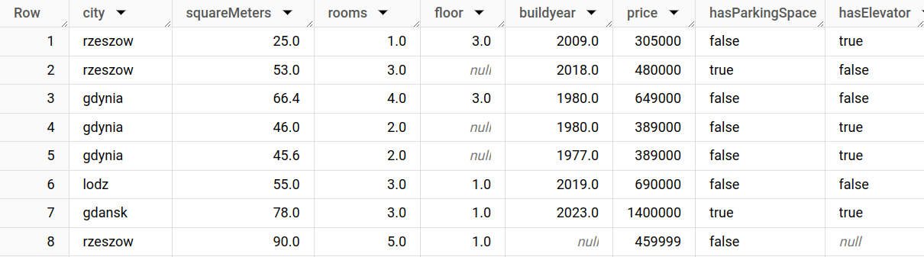
Scenario
These CSV files contain data like:

Slide 4
Problem Statement
They want a tool to:
“dump” their CSV files in,
and be able to analyze them later. (in SQL, or some reporting tool like PowerBI)

Slide 5
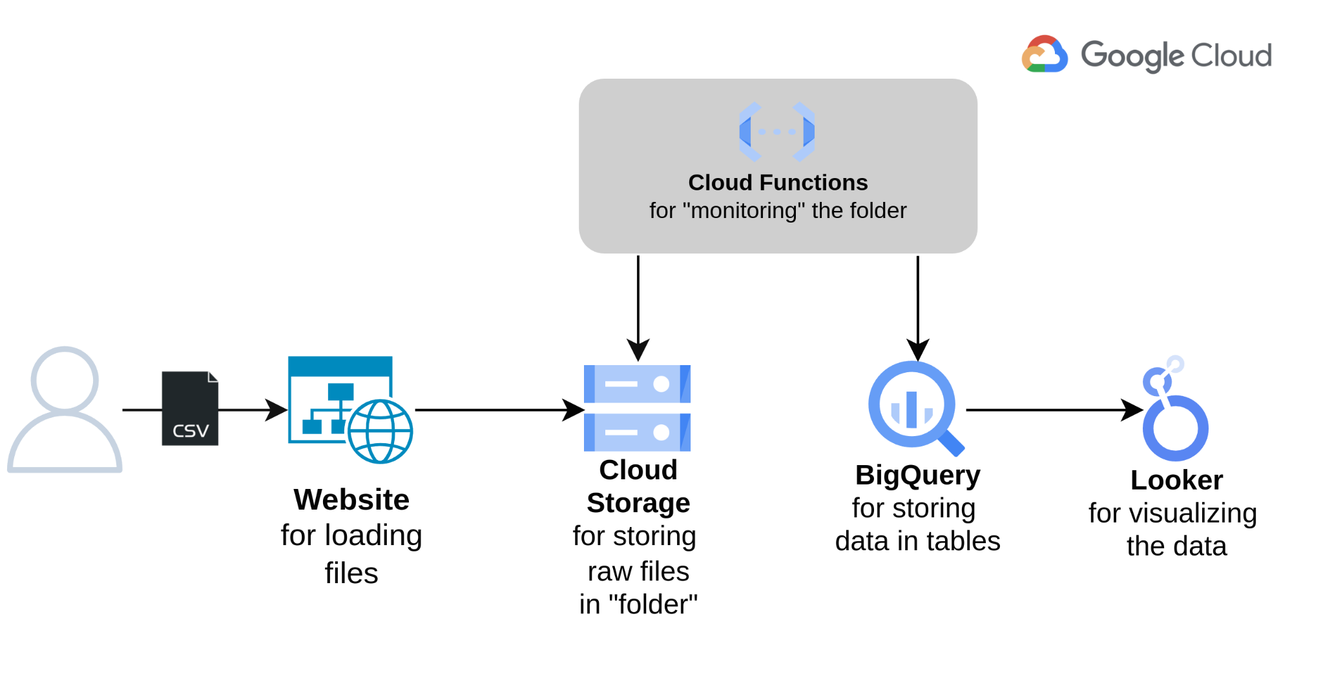
Architecture

Slide 6
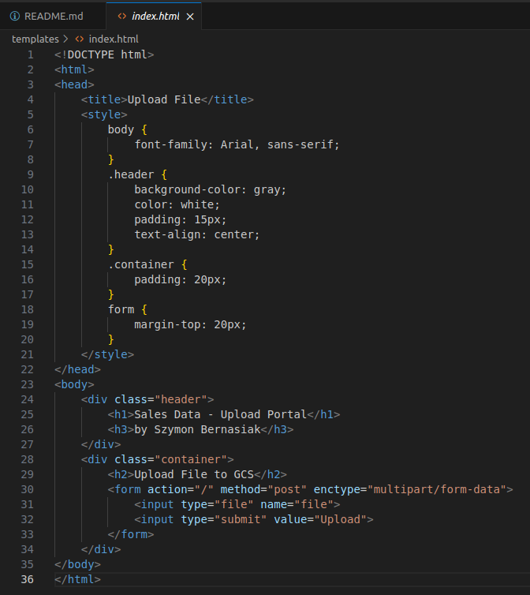
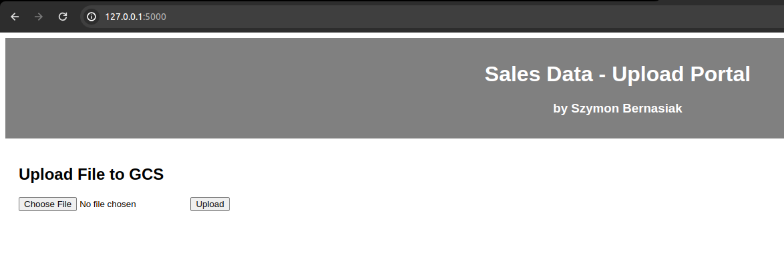
Demo - 1. Upload csv file

Slide 7
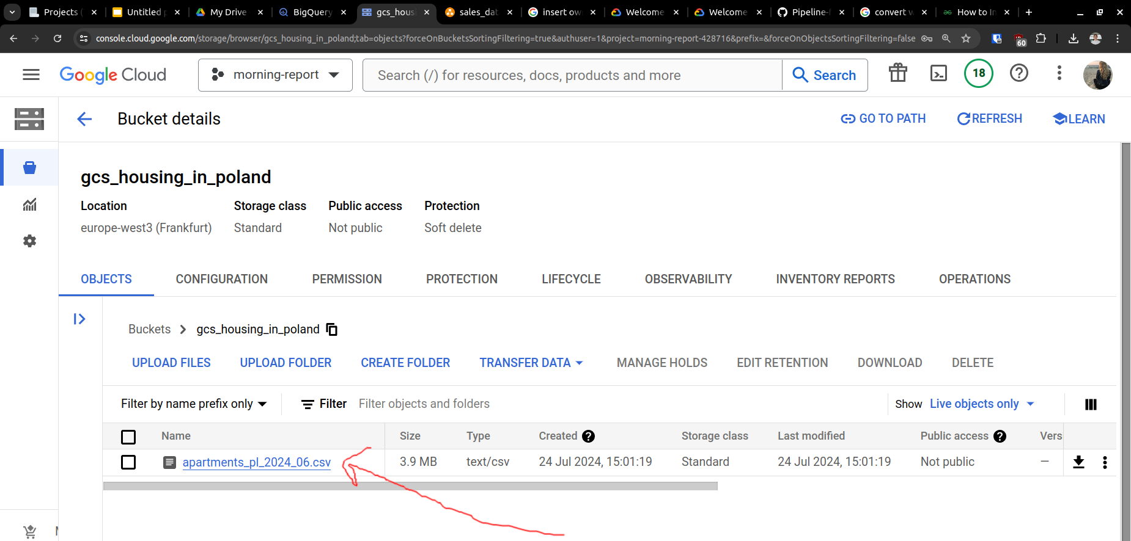
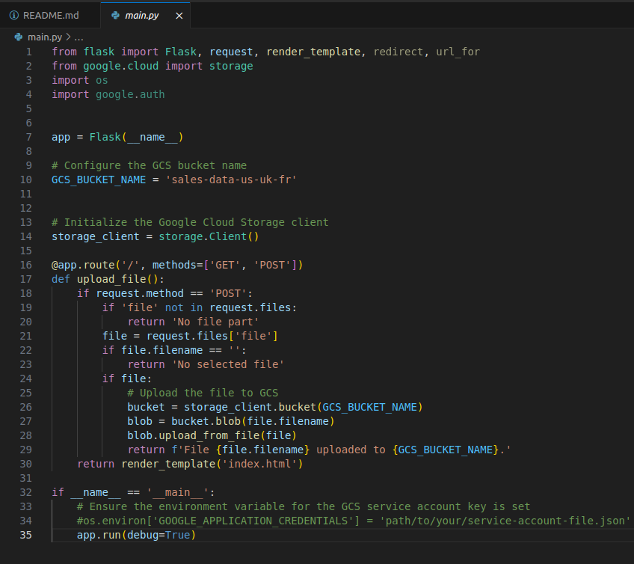
Demo - 2. File lands in Cloud Storage

Slide 8
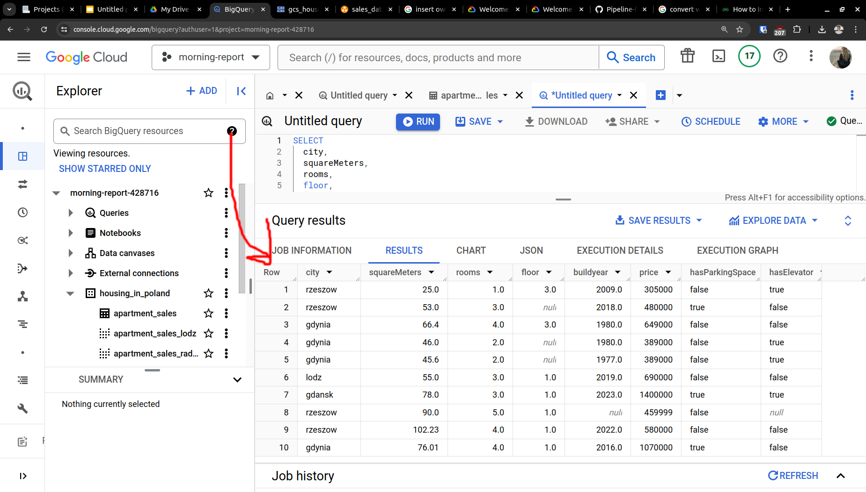
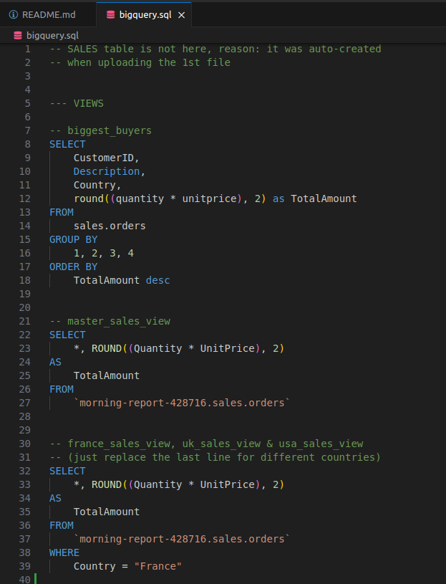
Demo - 3. Data gets loaded into a database

Slide 9
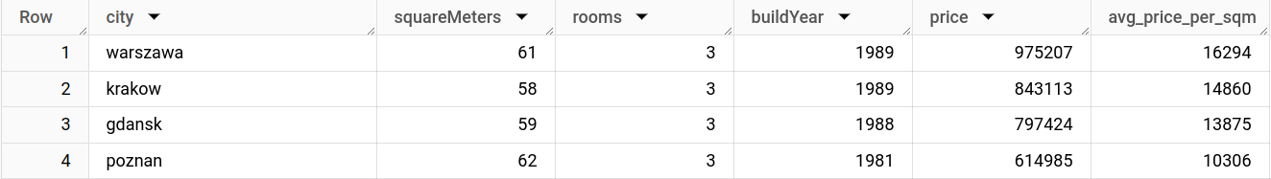
Demo - 4. Report is prepared

Slide 10
Thoughts
Coding is not as easy as it looks. Respect to the developers

Slide 11
Thoughts
Coding is not as easy as it looks. Respect to the developers
It would be 100x more difficult if I had to “comply with regulations”...

Slide 12
Thoughts
Coding is not as easy as it looks. Respect to the developers
It would be 100x more difficult if I had to “comply with regulations”...
Seeing a “bigger picture” is crucial. This is where we can sometimes help the developers

